Slide 1
Study Abroad Ghana
The Sankofa Project
PURDUE UNIVERSITY 2013

Slide 2
ACCRA COAST

Slide 3
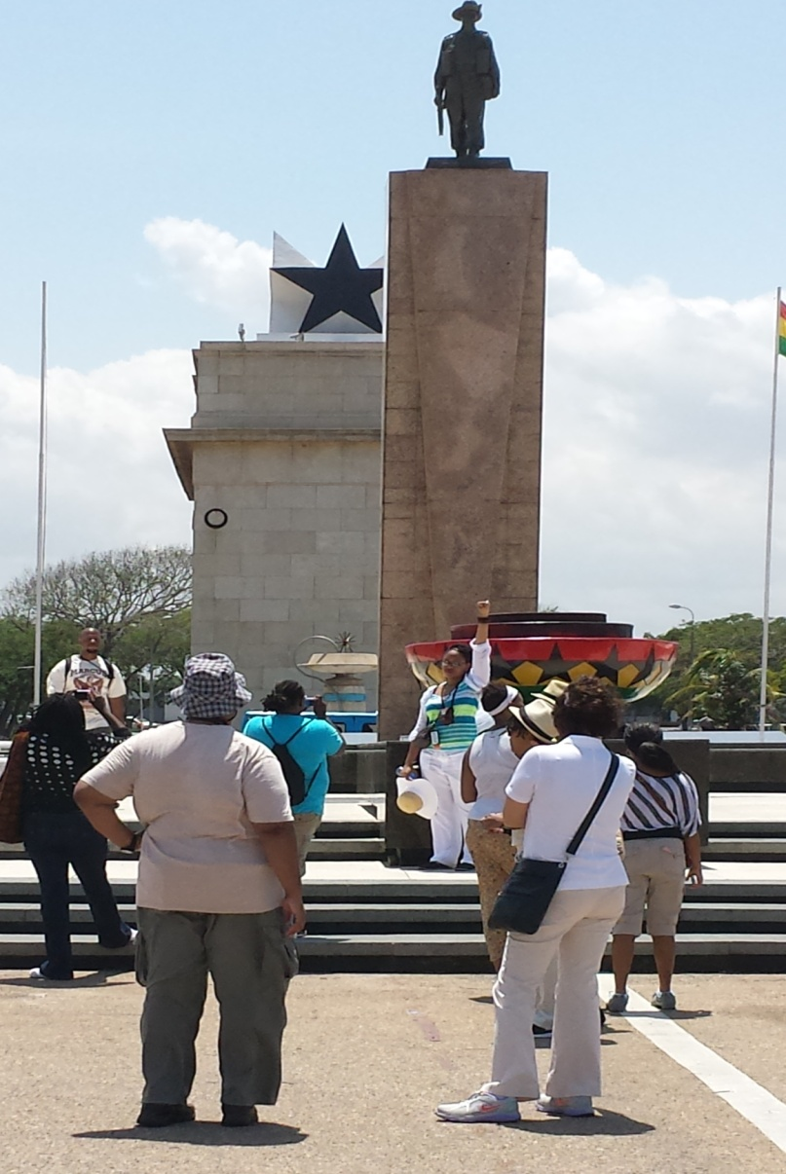
FREEDOM FIGHTERS
BLACK STAR

Slide 4
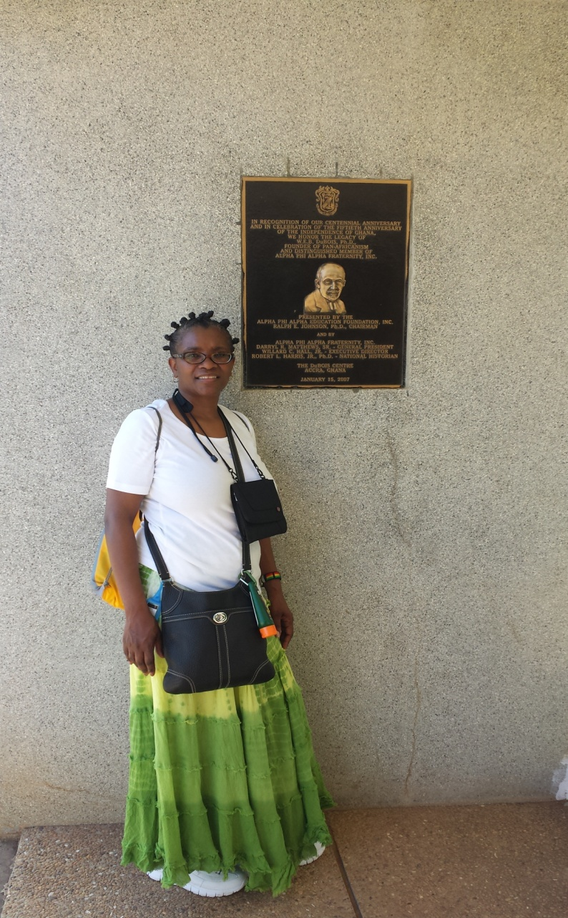
BLACK STAR
PATTON/DU BOIS

Slide 5
BEHEADED KWAME-KHRUMAH

Slide 6
AFRICAN DANCERS

Slide 7
AFRICAN DANCERS 2

Slide 8
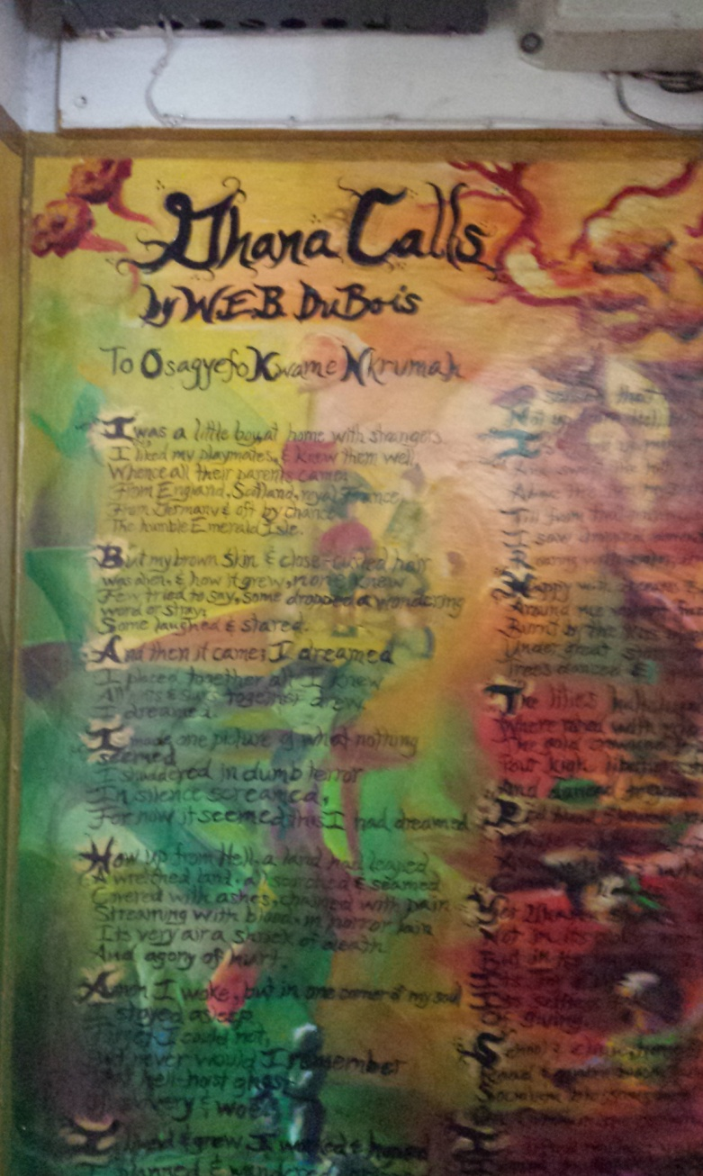
DUBOIS BURIAL
GHANA CALL DU BOIS

Slide 9
DU BOIS FAMILY

Slide 10
STUDENTS JOINING DANCERS

Slide 11
VIEW OF THE COAST FROM BLACK STAR

Slide 12
KWAME KRUMAH MUSEUM

Slide 13
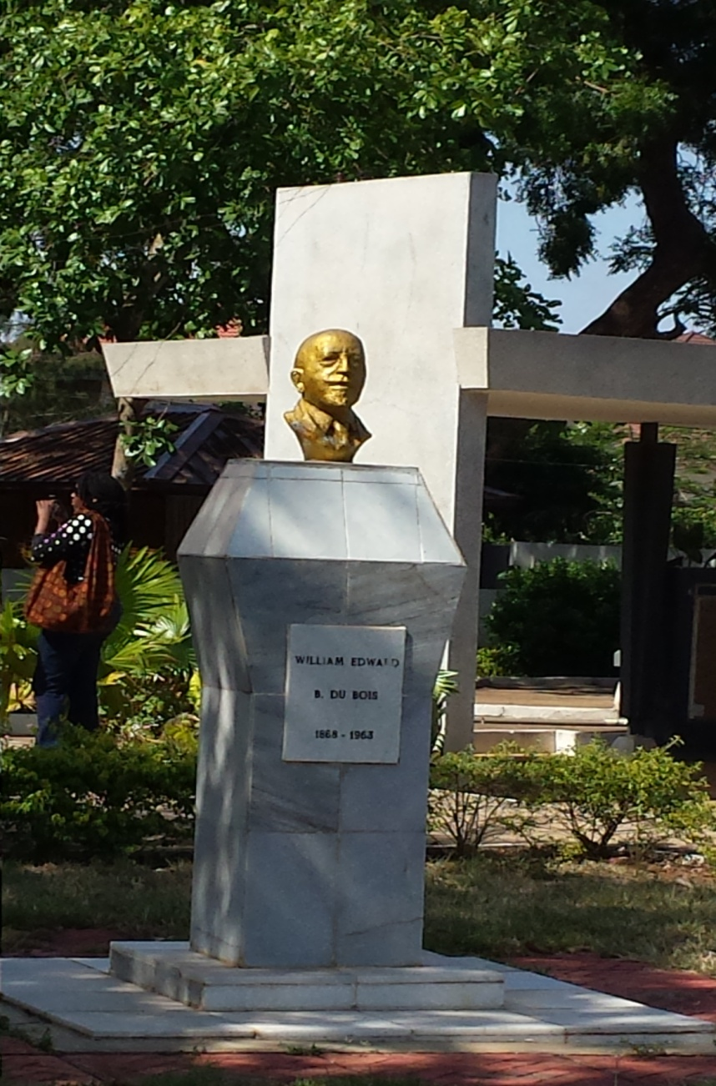
FIRST ANNUAL REPORT NAACP
DU BOIS BUST

Slide 14
HO, VOLTA REGION
STUDY ABROAD GHANA WEST AFRICA
PURDUE UNIVERSITY

Slide 15
ABURI BOTANICAL GARDENS

Slide 16
FEEDING THE MONKEYS

Slide 17
FEEDING MONKEYS 2

Slide 18
AFRICAN HOME

Slide 19
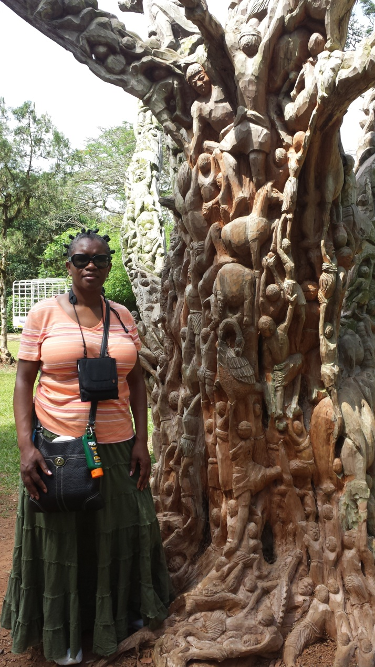
VERY LARGE TREE
PATTON/TREE OF LIFE

Slide 20
AFRICAN SHOP

Slide 21
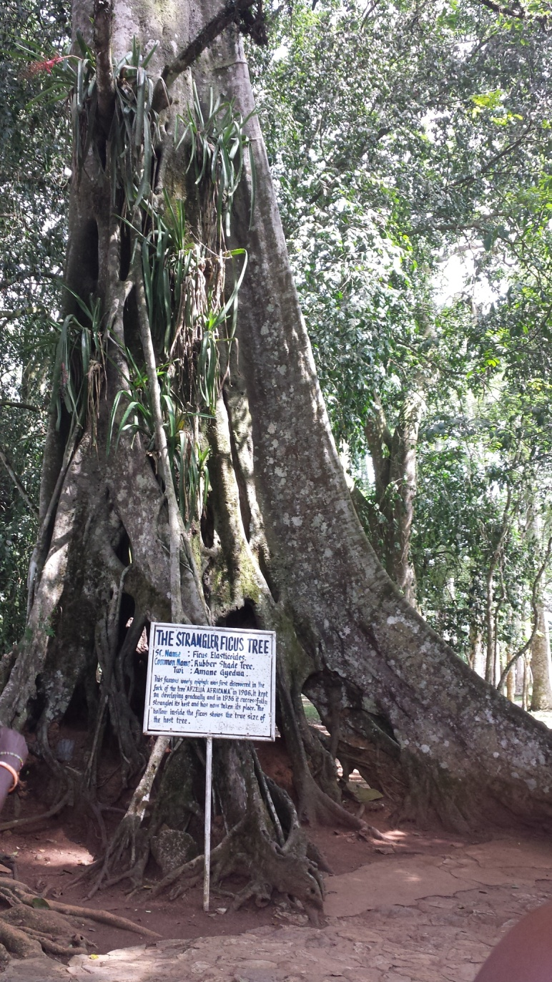
SHADE TREE
STRANGLER TREE

Slide 22
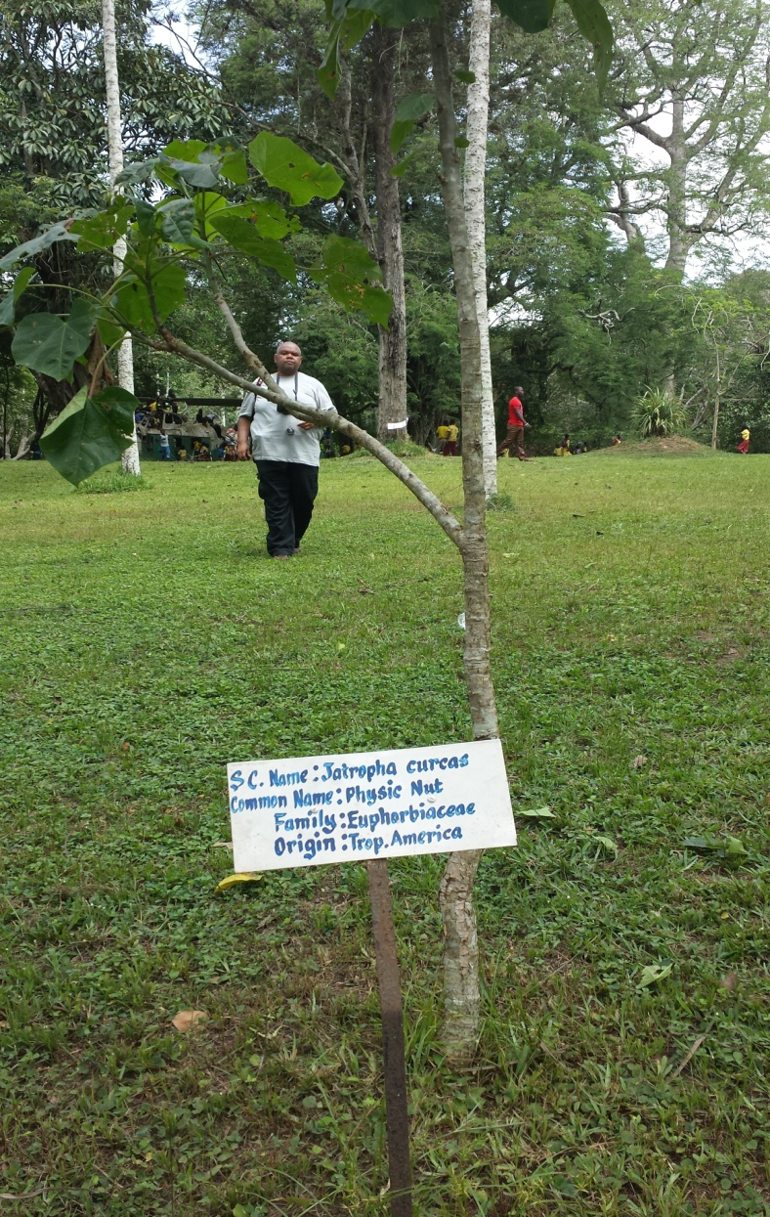
TREE OF LIFE SANKOFA
GARDEN

Slide 23
TREE OF LIFE

Slide 24
STUDENTS AT WATER FALL

Slide 25
STUDENTS AT WATERFALL 2

Slide 26
KUMASI
STUDENTS STUDY ABROAD GHANA
PURDUE UNIVERSITY

Slide 27
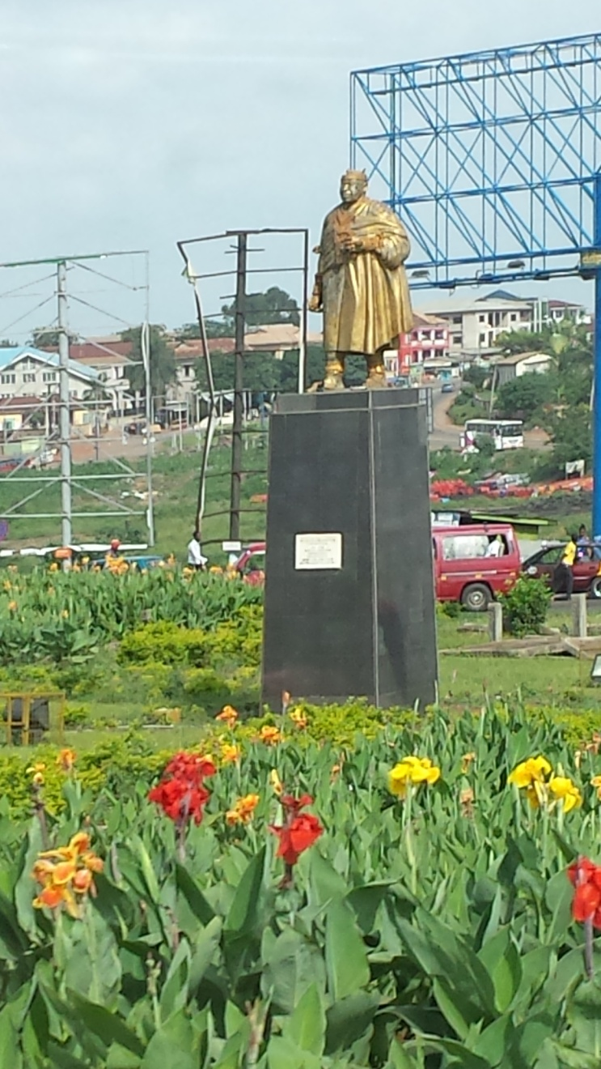
KUMASI

Slide 28
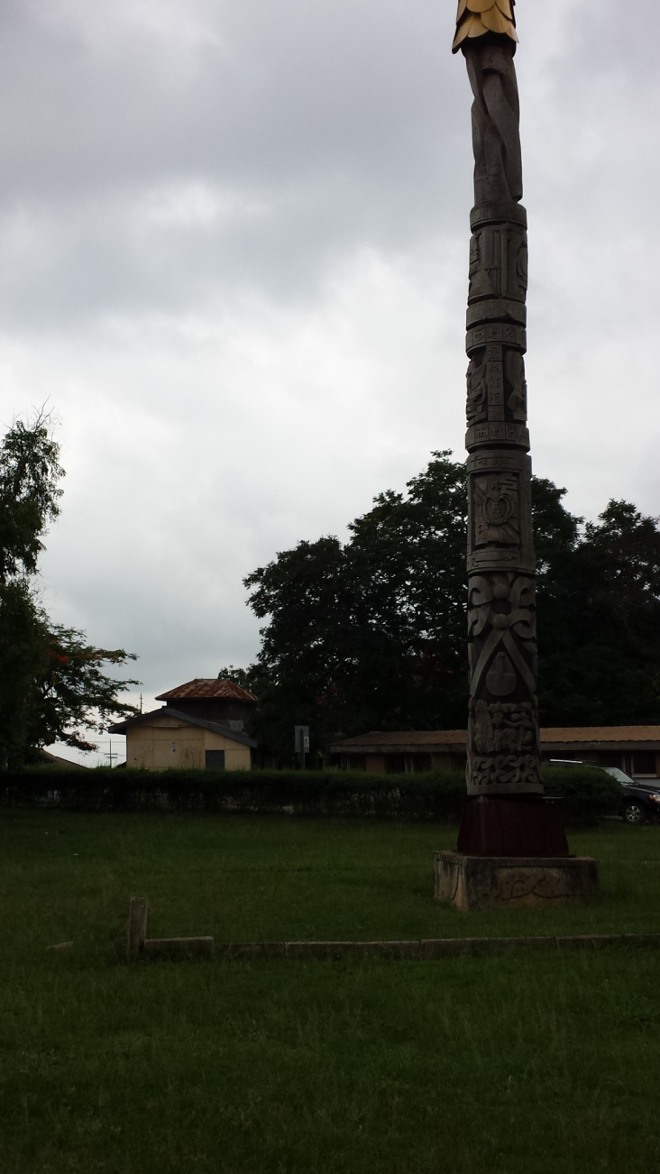
CLOTHE COLORING

Slide 29
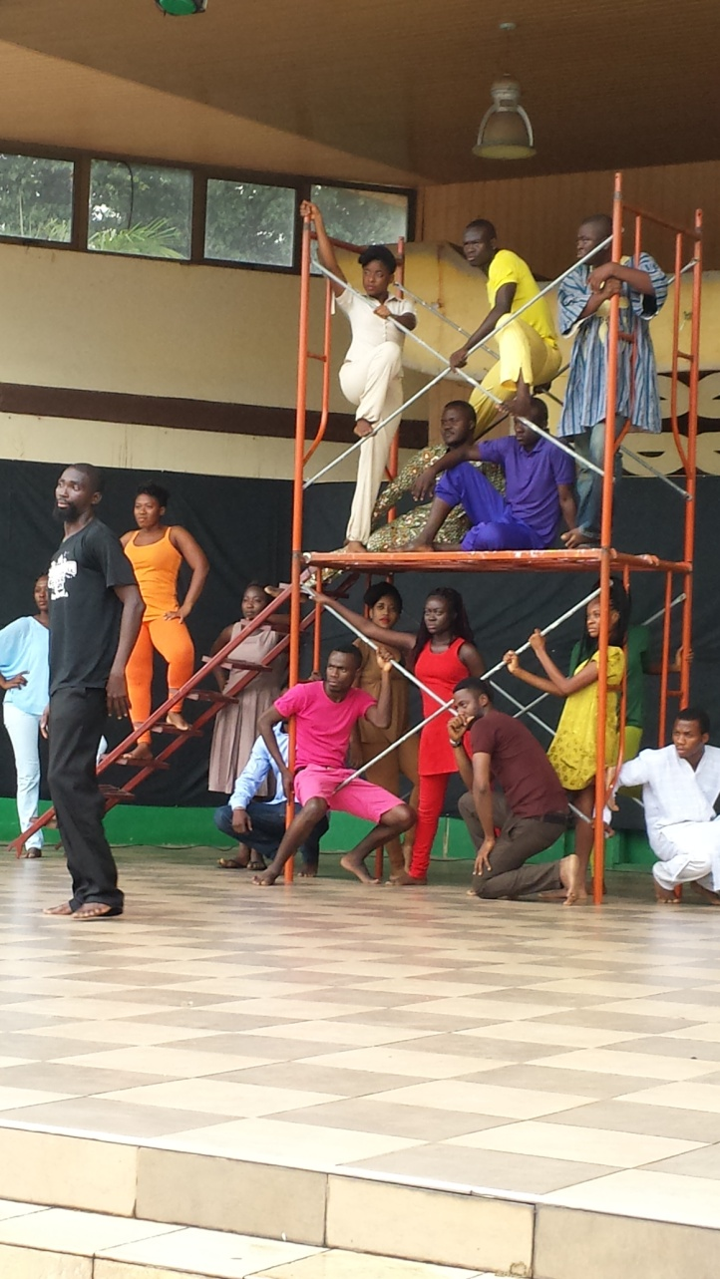
DANCERS

Slide 30
DANCERS 2

Slide 31
MUSICIANS

Slide 32
WEAVING

Slide 33
CAPE COAST
STUDY ABROAD
PURDUE UNIVERSITY

Slide 34
POLICE STATION

Slide 35
SLAVE FORT

Slide 36
SLAVE FORT 2

Slide 37
SLAVE CASTLE

Slide 38
SLAVE FORT

Slide 39
SLAVE FORT

Slide 40
SLAVE CASTLE

Slide 41
SLAVE CASTLE COAST VIEW

Slide 42
SLAVE HOLDING CELL

Slide 43
INSIDE VIEW

Slide 44
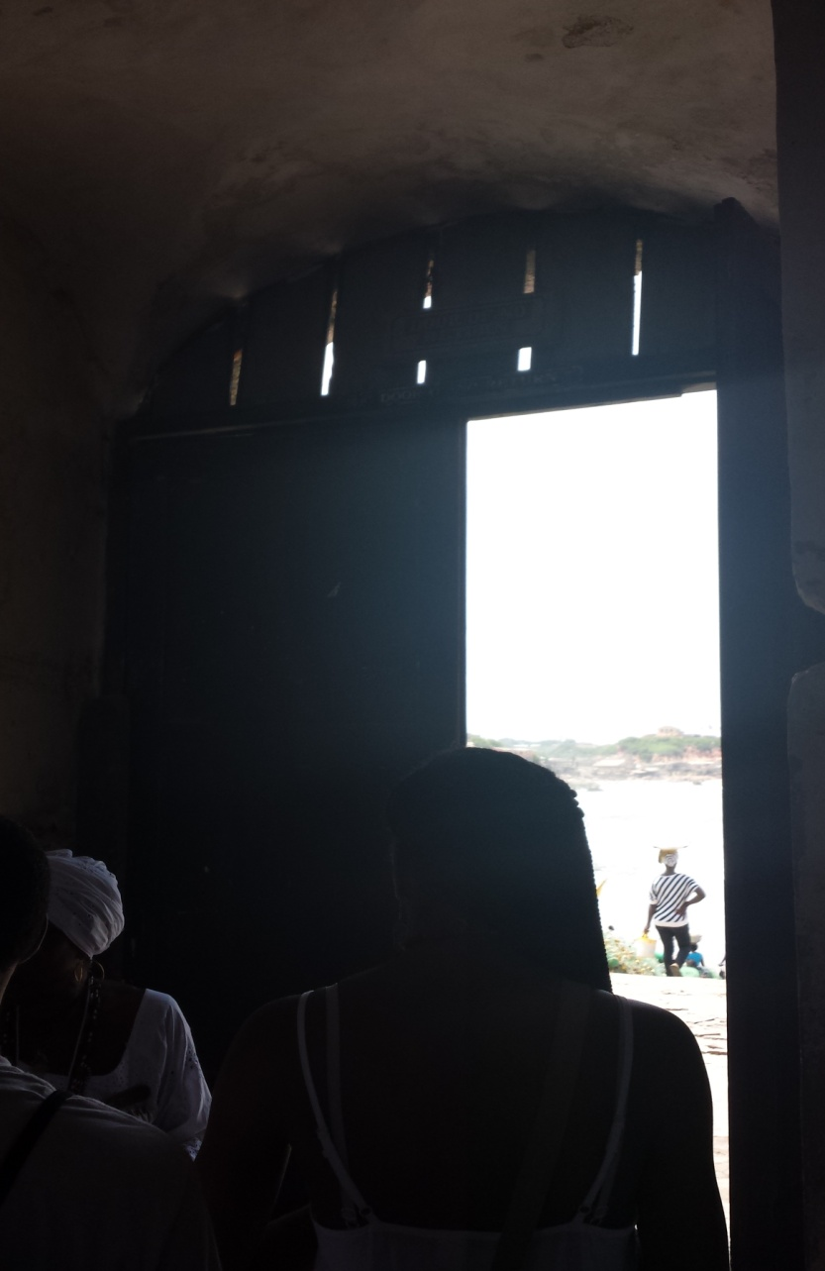
SLAVE CELL
DOOR OF NO RETURN

Slide 45
HOLDING CELLS FOR SLAVES

Slide 46
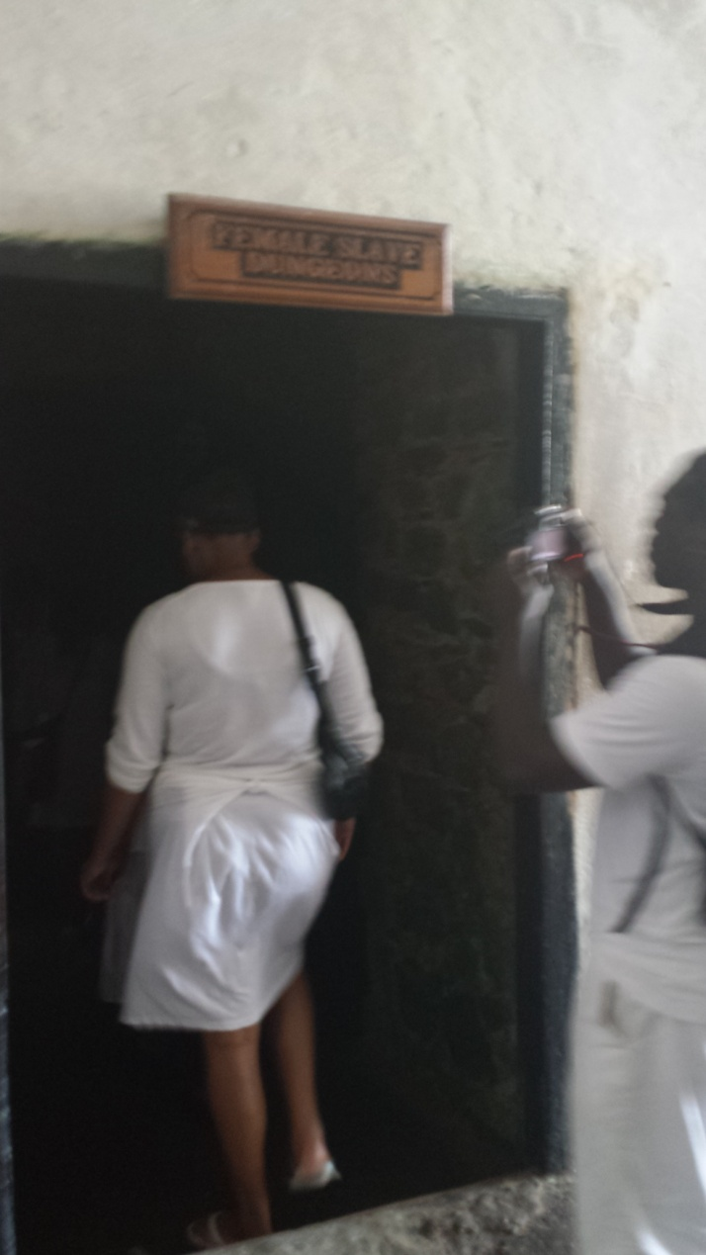
DOOR OF NO RETURN

Slide 47
SLAVE HOLE

Slide 48
PALAVER HALL

Slide 49
PEEP HOLD AT AMSTERDAM

Slide 50
SLAVE TUNNEL

Slide 51
DUNGEON AT FORT AMSTERDAM

Slide 52
FORT AMSTERDAM

Slide 53
CAPE COAST CASTLE

Slide 54
MEMORY PLAQUE

Slide 55
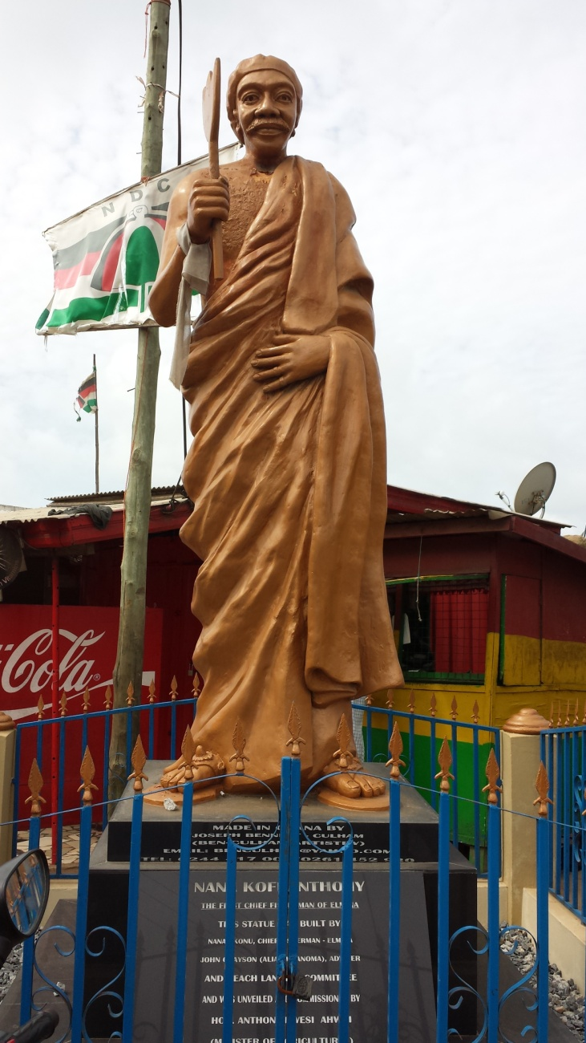
CHIEF GYAN

Slide 56
LEAVING COAST CASTLE

Slide 57
RITE OF PASSAGE

Slide 58
RITE OF PASSAGE 2

